Slide 1
Cultural Geography
Geog 360 Human Geography
Dr. Jocoy

Slide 2
Learning objectives
Identify the characteristics of cultural geographic studies
Define culture, cultural landscape, placelessness, and in-place and out-of-place.
Identify human geographic concepts of importance in Fletchall’s 2016 article

Slide 3
1. Cultural Geographic Studies
Analyze & interpret the spatiality of culture
Explain the spatial patterns of cultural traits
Illustrate how humans create places through culture
Logic: Human geography is the study of the spatial organization of human activity and of people’s relationship to their environment. If studying culture, a human geographer would take an approach that emphasizes the location of culture and how culture develops in specific places.

Slide 4
2. Defining concepts
Culture - Social creations consisting of shared beliefs and practices that are dynamic.
Material culture – tangible and visible artifacts, implements, structures created by people – ex’s: clothing, hair styles
Non-material culture – oral traditions and behavioral practices – ex’s: songs, stories

Slide 5
2. Concepts cont.
Cultural Landscape – human modification of the surface of the earth to meet economic, political, and cultural needs (Carl Sauer)
Sense of place – emotional attachments people develop with specific localities; a component of collective identity of cultural groups (Yi Fu Tuan)
Place/Placelessness (Ted Relph)
Place – locations with meaning
Placelessness – location empty of meaning, lacking uniqueness or sense of place
ex: Geography of Nowhere (James Howard Kunstler)
Critique of auto-dependent suburbia for its lack of a distinctive sense of place and community civic life

Slide 6
2. Concepts cont.
In-place/Out-of-place (Tim Cresswell)
Sense of belonging or not belonging in a place
Exclusion or Inclusion in a geographic location or spatial arrangement
Concepts of social mix & segregation (August et al 2017 opinion in The Vancouver Sun)

Slide 7
3. Concept from Fletchall’s cultural geography research
Neolocalism (Wes Flack)
seeking out of local knowledge & attachment to a place to experience a feeling of connection with a unique culture
Place-making
actively constructing material and non-material culture associated with a location
Creating meaningful experiences in and of place

Slide 8
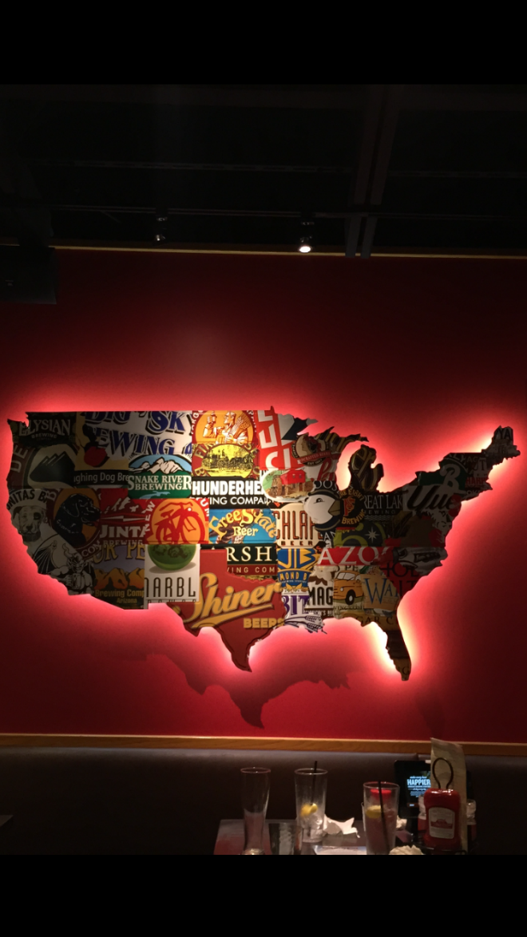
From a Red Robin restaurant (Provided by a former Geog 360 student in Sept 2015)

Slide 9
What makes Fletchell’s article a Human Geographic study?
What makes it cultural geography?
Notes:
If out of time put up answers on the white board.

Slide 10
Cultural Geogrpahy CR-1 Small Group Discussion
Huizinga, R.P. & B. van Hoven. (2018) Everyday Geographies of Belonging: Syrian refugee experiences in the Northern Netherlands, Geoforum 96: 309-317.

Slide 11
Geoforum Journal
Webpage
https://www.journals.elsevier.com/geoforum
Review to understand the subject matter published in this journal.

Slide 12
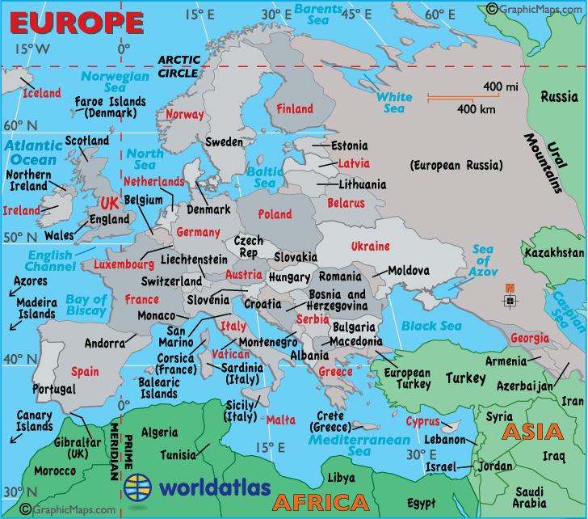

Slide 13
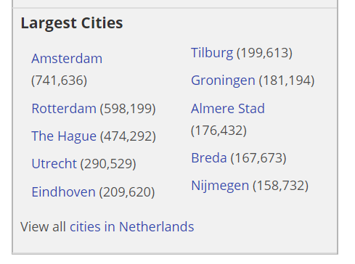
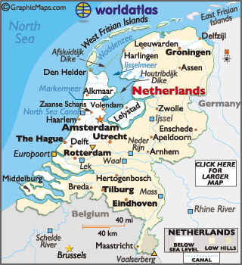
2017

Slide 14
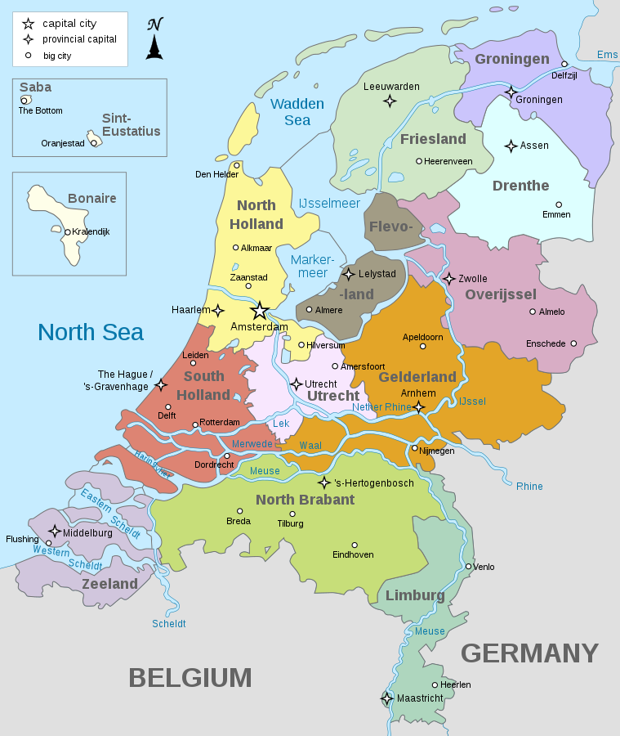
Research context
Geographic Setting:
Northern Netherlands-
3 provinces
Wikimedia Commons

Slide 15
Syrian Refugees in the Netherlands
Refugee – one who flees to another country out of concern for personal safety or to avoid persecution
Asylum – protection from persecution granted by one country to a refugee from another country.
Conflict in Syria – 2011 Arab Spring uprisings & civil war 2011-present
Bashar al-Assad (Incumbent) neo-Ba'athist government | 2000-Present Operates as authoritarian

Slide 16
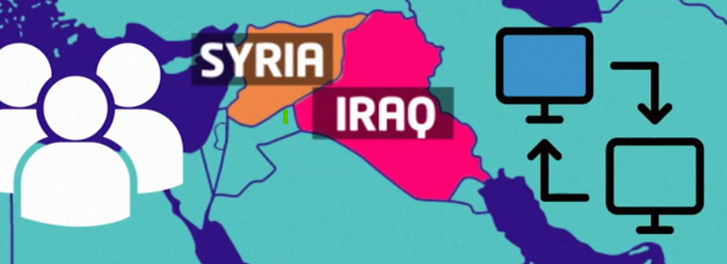
Conflict in Syria
Overview from BBC, Apr 2018 https://www.bbc.co.uk/newsround/16979186
Participants
Government of Bashar al-Assad
Rebels against the government
Islamic State (IS, ISIS, or ISIL)
Uses internet and social media to spread their ideas
Recruits new members

Slide 17
Asylum policy in the Netherlands
Spatial dispersal policy
See article for definition
Refugee integration
See article for definition
Types of spaces where intercultural encounters may occur
Home – “first place”
Work – “second place”
Home away from home – “third place”
Transitory zones – public spaces outside home & work; in-between places like sidewalks, public transport, waiting lines, lobbies

Slide 18
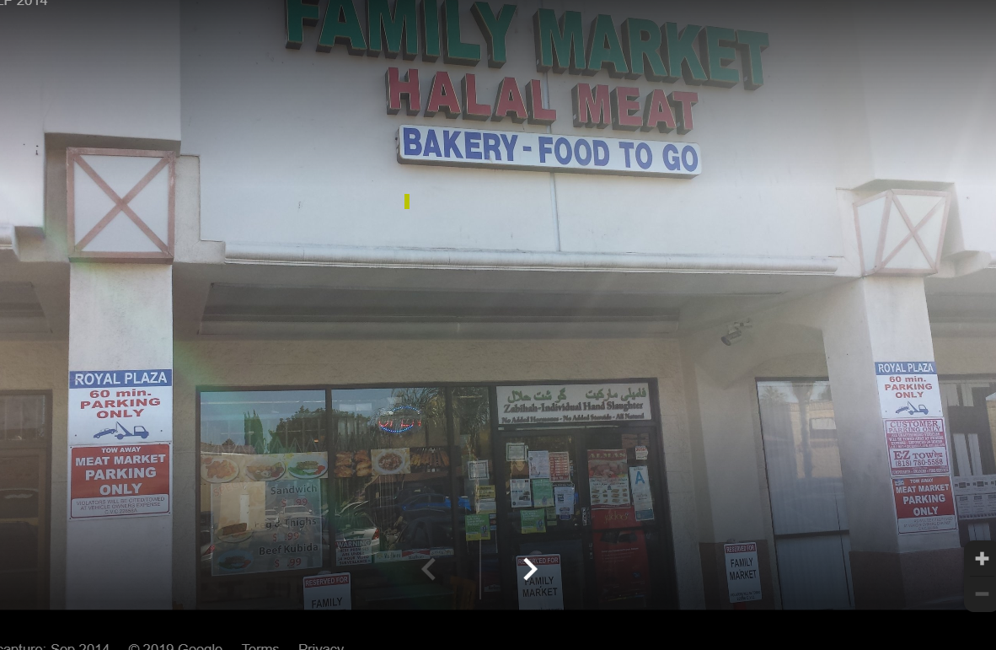
What is halal meat?
Halal is Arabic for permissible. Halal food is that which adheres to Islamic law, as defined in the Koran.
The Islamic form of slaughtering animals or poultry, dhabiha, involves killing through a cut to the jugular vein, carotid artery and windpipe.

Slide 19
Concepts in Huizinga, R.P. & B. van Hoven 2018
Belonging See article for definition
A geographic approach to the cultural concept of belonging focuses on the role played by spatial inclusion & exclusion
Geographies of encounter
See article for definition
For this article, it is the locations where intercultural relationships could develop

Slide 20
Concepts in Huizinga, R.P. & B. van Hoven 2018
Belonging – spatial inclusion & exclusion
Place-belongingness or Sense of home p310
Transnational sense of belonging p311
Geographies of encounter
Encounter hypothesis – increased familiarity & tolerance, changing attitudes toward cultural “others” comes with familiarity
Intercultural encounters of refugees
Everyday encounters: where people interact
Transitory spaces (in-between, used to get from one place to another – sidewalks, waiting rooms, public transport)
Third spaces (outside home and work; public spaces)
“New place” of belonging – refugee’s home engages with everyday life in new place (Turkish supermarkets)

Slide 21
Findings
Which spaces and activities contributed to feelings of belonging for Syrian refugees?
Which spaces and activities impeded feelings of belonging for Syrian refugees?

Slide 22
Implications of results
Knowledge of refugees’ everyday experiences of the spatial dispersal policy
Challenge the existing policy approach to integration
Suggest creating spaces for migrant transnationalism & belonging
Suggest public relations campaign to educate about methods for refugee integration

